Slide 1
Web Chat
A Project using on node.js & socket.io

Slide 2
Introduction
A very simple cross- platform client-server chat application has been implemented in node.js with socket.io. Its design is described, limitations are discussed, improvements are proposed and a user manual is included.
Implementing a chat server application provides a good opportunity for a beginner to design and implement a network-based system. The design is done with CSS. It is implemented with node.js and socket.io, since is easy to program in, it precludes the need to deal with low-level memory management and includes powerful libraries for sockets and threads.

Slide 3
Node.js & socket.io
Node.js is a platform built on Chrome's JavaScript runtime for easily building fast, scalable network applications. Node.js uses an event-driven, non-blocking I/O model that makes it lightweight and efficient, perfect for data-intensive real-time applications that run across distributed devices.
Socket.IO is a JavaScript library for real-time web applications. It enables real-time, bi-directional communication between web clients and servers.

Slide 4
Objectives & Requirements
The Application requires for the chat communications between people, so there will private web chat rooms based website in which two people can interact with each on the platform. When Chat Room is created, another member could join the room with given link, by providing name and e-mail address. There could be multiple chat rooms and many people chatting through them.
The USP of the system is that all the client application is based on JavaScript, which makes the system very fast a user friendly. Secondly the system will provide the user with easy to use and understand graphic interface. User can easily interact with the system with menus and text areas.

Slide 5
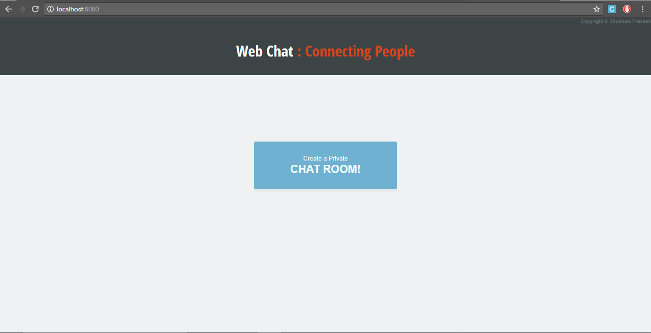
Home Page

Slide 6
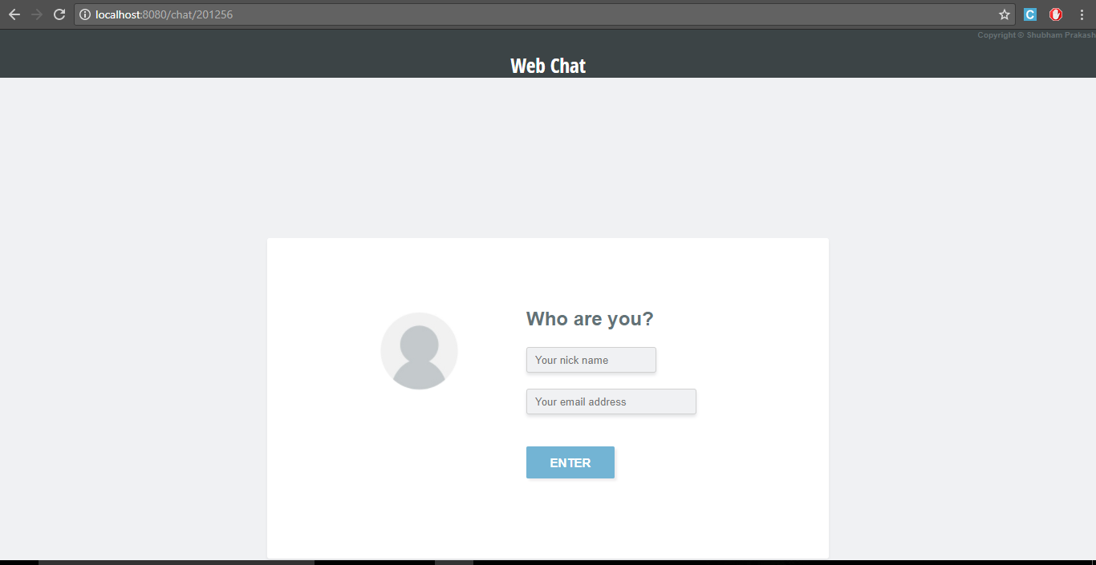
After Creating A ChatRoom

Slide 7
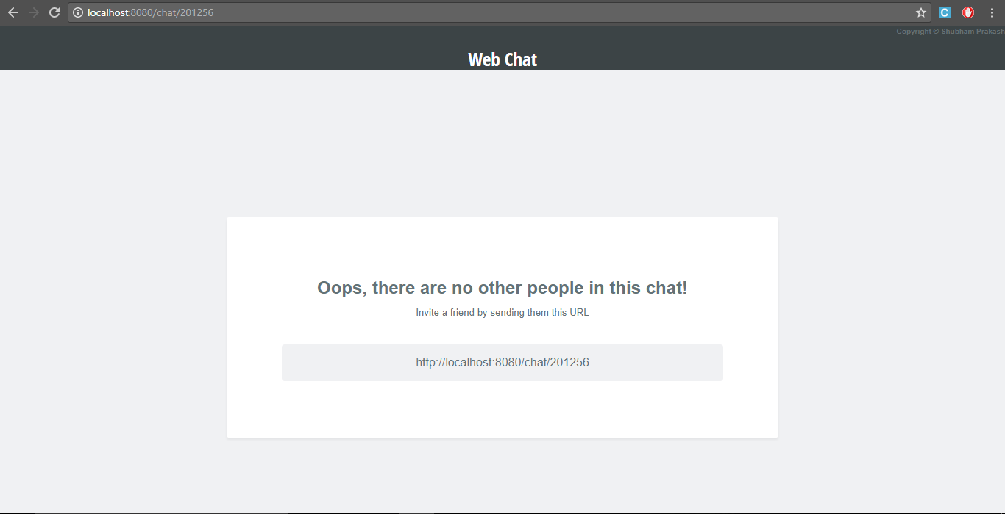
After Login

Slide 8
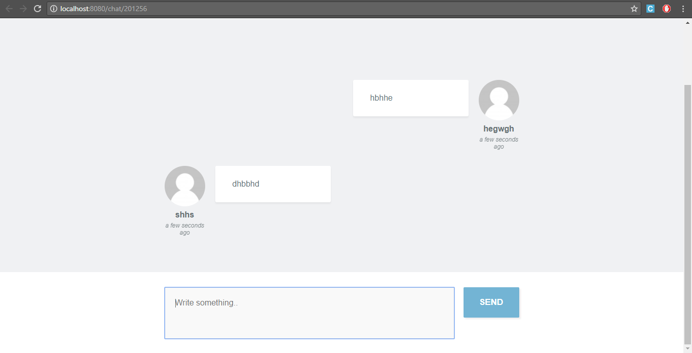
Once partner is Connected

Slide 9
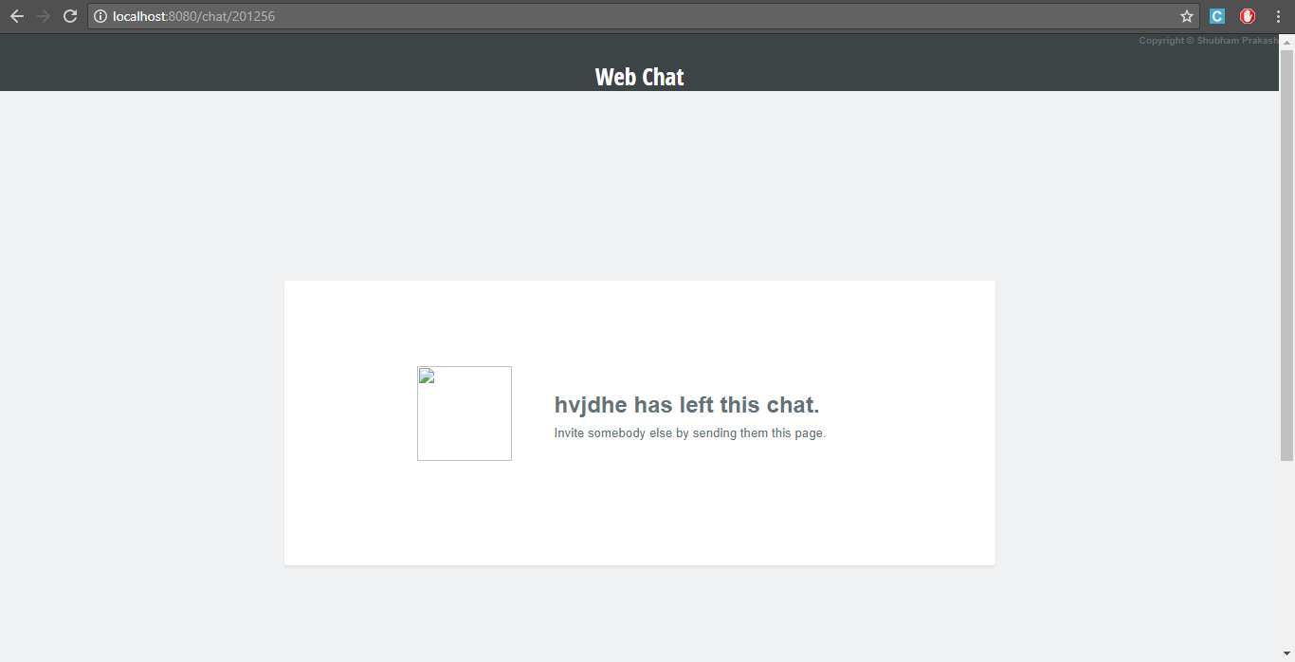
If your Partner leaves

Slide 10
Future Scope
Connecting to a database such that user’s information can be stored
Don’t send the same message to the user that sent it himself. Instead, append the message directly as soon as he presses enter.
Add “{user} is typing” functionality
A facility for Group Chat
Help and Feedback Sections

Slide 11
References
http://www.programwitherik.com/getting-started-with-socket-io-node-js-and-express/
https://socket.io/get-started/chat/
http://cdnjs.cloudflare.com/ajax/libs/jquery/1.10.2/jquery.min.js/

Slide 12
Thank You
A Presentation by Shubham Prakash

